Slide 1

Synthetic Data Generation Using AI
Applications of Synthetic Data Generation in Oil and Gas Industries
Synthetic data generation using AI is becoming an increasingly popular technique across various fields. In this presentation, we will explore the advantages, limitations, and future developments of this exciting field.

Slide 2

Introduction to Synthetic Data Generation
1
What is Synthetic Data?
2
Why is Synthetic Data Useful?
3
How is Synthetic Data Generated?
Synthetic data is artificially generated data that mimics the characteristics of real data.
Synthetic data can be easily generated and used for testing and simulation without the privacy and security risks associated with real data.
Synthetic data is generated using machine learning algorithms that can learn from real data and mimic its characteristics.

Slide 3
Advantages of Using Synthetic Data
1
Privacy
2
Diversity
Synthetic data can be used to protect sensitive information and still maintain the usability of the dataset.
Synthetic data can be generated with a wide variety of features, allowing for a more diverse training data set for AI models.
3
Cost-effectiveness
4
Customizability
Creating synthetic data is less expensive than collecting and annotating real-life data, making it a cost-effective solution for companies with limited budgets.
With synthetic data generation, researchers can create custom datasets tailored to their specific AI models and research objectives.

Slide 4
Why Synthetic Data Generation is Important for Oil and Gas Industries
Risk-Free Testing
Improved Resource Allocation
Data Optimizatio
Simulating drilling or well operations using synthetic data eliminates risk and reduces costs associated with testing on the field.
Synthetic data can be used to improve data quality by helping to resolve missing or corrupted data, leading to better decision making.
Synthetic data generation provides a faster and more accurate way to assess the applicability of technologies, resource usage and cost comparisons in the Oil and Gas industry

Slide 5
Limitations and Challenges of Synthetic Data Generation
Data Bias
Data Quality
Synthetic data generated from biased AI models can only reinforce and exacerbate existing biases present in real data.
The quality of synthetic data generated is highly dependent on the quality of the source data used to generate it.
Realism
Unknown Unknowns
Generating synthetic data that accurately mimics reality can be a challenging task.
Synthetic data generated by AI models can sometimes highlight novel or unusual phenomena that may have been missed otherwise.

Slide 6

How AI Can Be Used for
Synthetic Data Generation
AI techniques such as Generative Adversarial Networks (GANs) and Variational Autoencoders (VAEs) have revolutionized the way synthetic data is generated. These models can now create highly diverse, high-quality synthetic data sets that can enrich training data for AI models.

Slide 7
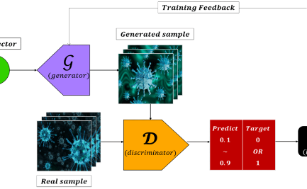
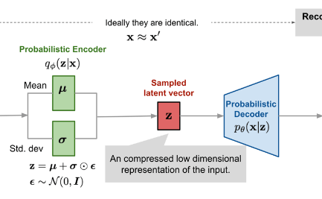
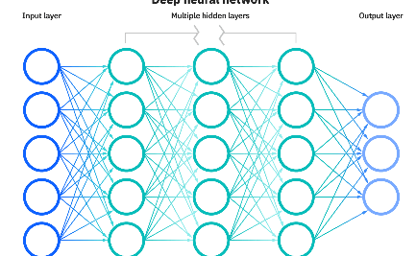
Types of AI Models for Synthetic Data Generation-1
Generative Adversarial Networks (GANs)
Variational Autoencoders (VAEs)
Neural Networks
Neural Networks can be used as generative models to produce synthetic data that mimics real data sets.
GANs consists of two neural networks - a generator and a discriminator - that work together to create highly realistic synthetic data.
VAEs generate synthetic data by learning latent parameters that describe the underlying distribution of the real data set.

Slide 8
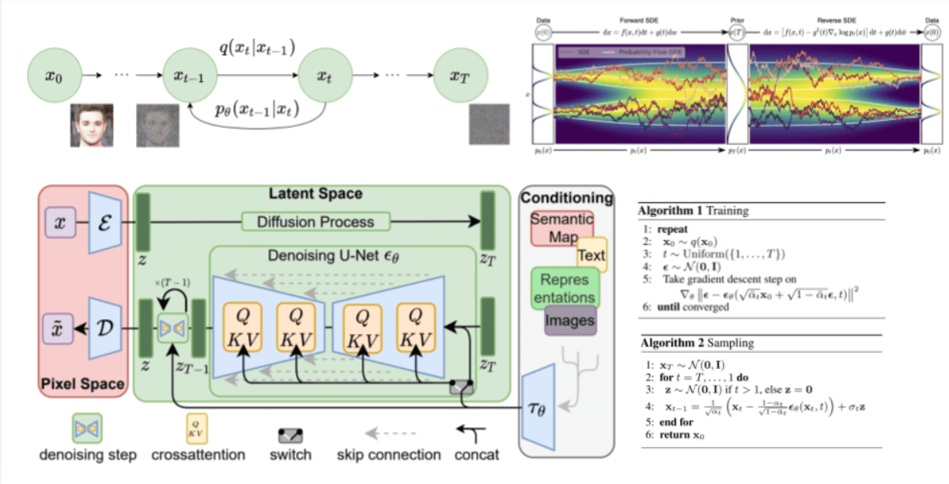

Types of AI Models for Synthetic Data Generation-2
ChatGPT
Stable diffusion models
take the input image and gradually add Gaussian noise to it through a series of steps. We will call this the forward process. Afterward, a neural network is trained to recover the original data by reversing the noising process. By being able to model the reverse process, we can generate new data. This is the so-called reverse diffusion process or, in general, the sampling process of a generative model.
ChatGPT, which stands for Chat Generative Pre-trained Transformer, is a large language model-based chatbot developed by OpenAI. In shell we have Shellified ChatGPT which we can expolore to generate synthetic data based on business need.

Slide 9
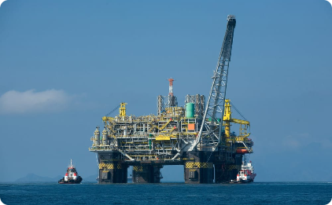
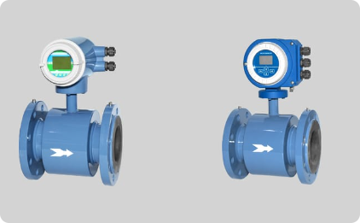

Applications of Synthetic Data in Exploration and Production
Offshore Exploration
Onshore Exploration
Production Operations
Synthetic data can assist in identifying potentially profitable areas for exploration and simulate drilling operations.
Generative artificial intelligence can simulate models to understand porosity, permeability, and fluid distributions on oil and gas production distribution networks
Synthetic data can help in identifying trends and patterns such as chunk or well depletion

Slide 10
Applications of Synthetic Data in Reservoir Management
Production Forecasting
Synthetic data can help in predicting future oil and gas production, Resource depletion, and also providing possible suggestions
1
2
3
Reservoir Characterization
Well Testing and Optimization
Synthetic data can be used for reservoir simulation, modeling and history matching during exploration or production.
Simulating well production rates is much more efficient using synthetic data than manual testing which can provide a comprehensive evaluation of exploration and production activities.

Slide 11

Applications of Synthetic Data in Drilling and Completion Optimization
Real-time Control and Optimization
Drill Log Data Prediction
Automatic Drilling Control
Using Synthetic data can provide proactive well control, monitor anomalies and optimize drilling outcomes
Synthetic data can also be used to predict drill log data such as Drill Rate of Penetration, Mechanical Specific Energy, Torque and Drag, giving an in-depth direction on the drilling patterns using Machine Learning techniques.
Synthetic data can enable autonomous drilling, creating smarter and safer operations with the oil and gas industry

Slide 12

Benefits of Using Synthetic Data in Oil and Gas Industries
1
Risk Reduction in Exploration and Production Processes
2
Improved Resource Allocation and Operational Efficiency
Synthetic data minimizes the risks and costs associated with testing on the field, reducing the drilling costs and associated risks.
Synthetic data provides faster and more accurate ways to assess the applicability of technologies, resource usage and cost comparisons, leading to improved operational efficiency.
3
Better Decision Making
Synthetic data can improve data quality by detecting patterns, resolving missing or corrupted data, and predicting likely outcomes, which all leads to better decision making.

Slide 13
Applications of Synthetic Data in Other Domains
Retail
Synthetic data can be used to personalize customer experience, optimize pricing strategies, and improve inventory management.
1
2
3
Healthcare
Autonomous Vehicles
Synthetic medical data can be used to train AI models that can accurately diagnose a wide variety of health conditions and diseases.
Synthetic data can be used to train self-driving cars to navigate a wide variety of road conditions.

Slide 14
Future Directions and Potential Developments in
Synthetic Data Generation Using AI
Improved Realism
Robustness to Noise
New Applications
Future AI models will generate synthetic data that is even more realistic and closer to real data.
AI models may be able to generate synthetic data that is more robust to noise and better able to cope with real world variations and uncertainties.
Synthetic data generated by AI models may be used in a wider variety of applications, including those not yet thought of.

Slide 15

Conclusion and Future Developments
"Using Synthetic data in oil and gas industry has revolutionized the exploration and production operations. However, we have only scratched the surface in terms of its full potential. We have a bright future ahead of us; as long as we continue to explore new possibilities and applications, we can make great strides in optimizing the oil and gas industry operations."

